Slide 1
10-bit Monotonic SAR ADC

Slide 2
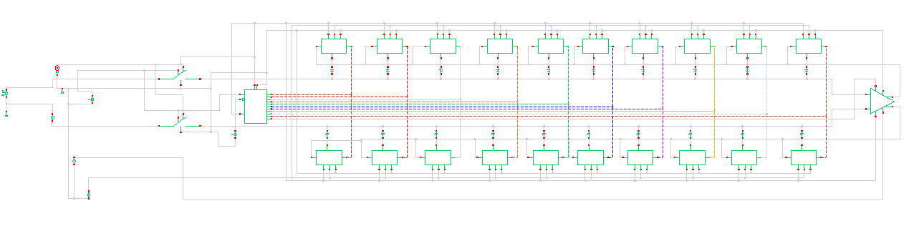
Fig. Schematic of 10-bit Monotonic SAR ADC

Slide 3
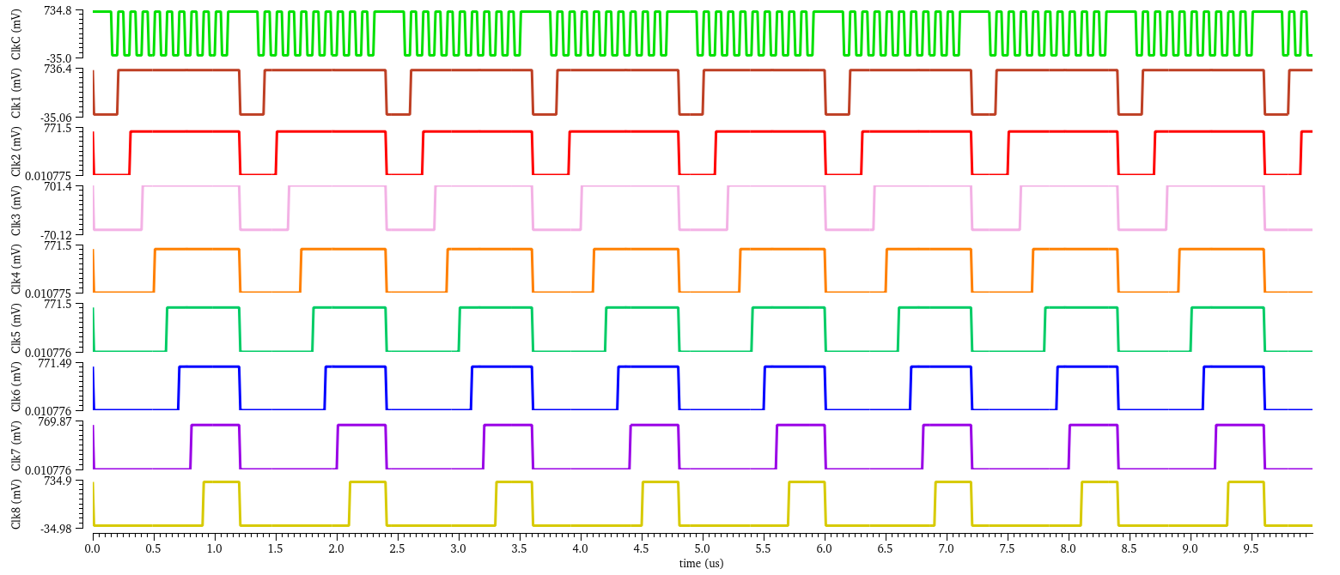
Control Signals Generation (Produced Using sampling clock and conversion clock)

Slide 4
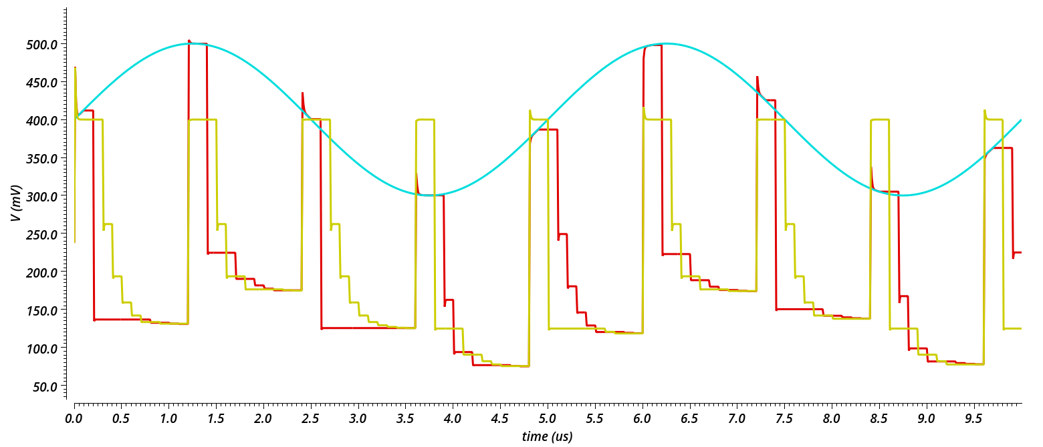
f_{s} =800KHz, f_{comp} = 10MHz, LSB =0.55mV, V_{DAC}=550mV, V_{supply}=0.7V, V_{comp,bias}=0.4V
Vcin
Vcip
Vin_{sw+}

Slide 5
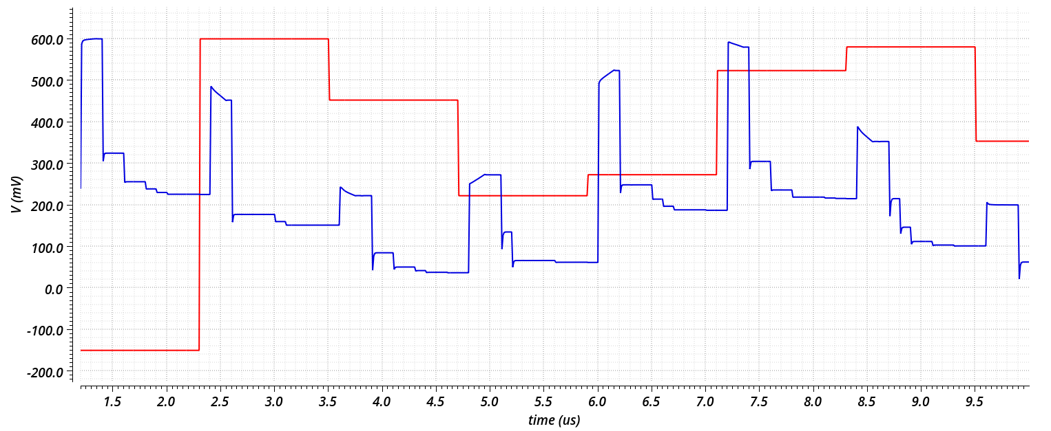
V_{op} (Reproduced using DAC from ADC) , V_{in cap array}

Slide 6
40nW
300nW
160nW
164nW

